Slide 1

FastGAN: Faster and Stabilized GAN
Mauro Ficorella 1941639 | Martina Turbessi 1944497 | Valentina Sisti 1952657

Slide 2
Introduction
Our work is based on the paper “Towards Faster And Stabilized Gan Training For High-fidelity Few-shot Image Synthesis”.
OBJECTIVES:
Allow users with limited computing budget and resources to train a GAN;
Eliminate the requirement of a big dataset for training;
Allow to train models from scratch in order to avoid biases typic of the pre-trained models and to let people use their own set of interest images;
Few hours required for training time;

Slide 3
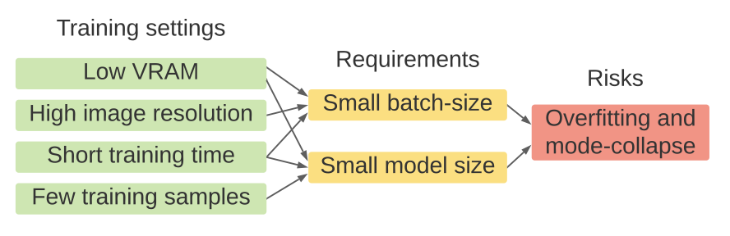
Gan’s Problems
Accelerate training: this problem has been approached from various perspectives, but this brought only very limited improvements in training speed, while not enhancing quality within the shortened training time;
High resolution training: this made GAN much harder to converge. There were some approaches trying to solve this problem, but they led to a slightly greater computational cost, consuming more GPU memory and requiring more training time;
Stabilize training: mode-collapse on the generator is a big challenge when training GANs, given fewer training samples and lower computational power and budgets (smaller batch-size). There were approaches that tried to solve this problem, but they worked only on low resolution images with unlimited computing resources.

Slide 4
FastGAN Solution
FastGAN reaches the objectives based on the following two techniques:
Skip-Layer channel-wise Excitation module: revises channel responses on high-scale feature-maps using low-scale activations and allows to reach a faster training using a more robust gradient flow throughout the model weights;
Self-supervised discriminator D trained as a feature-encoder with an extra decoder: this discriminator is forced to learn a feature-map that covers more regions from an image in input; in this way it gives richer signals in order to train G. It has been shown that auto-encoding is the best self-supervision strategy for D.

Slide 5
In order to optimize GANs with respect to the SOTA models, in FastGAN is adopted a lightweight model, using a single convolutional layer on each resolution in the generator.
On the high resolutions in both generator and discriminator, only three channels for the convolutional layers are applied in input and output. This structure helps making FastGAN faster to train, remaining, at the same time, strong on small datasets.

Slide 6
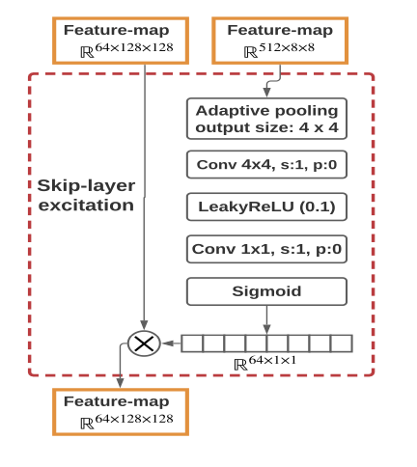
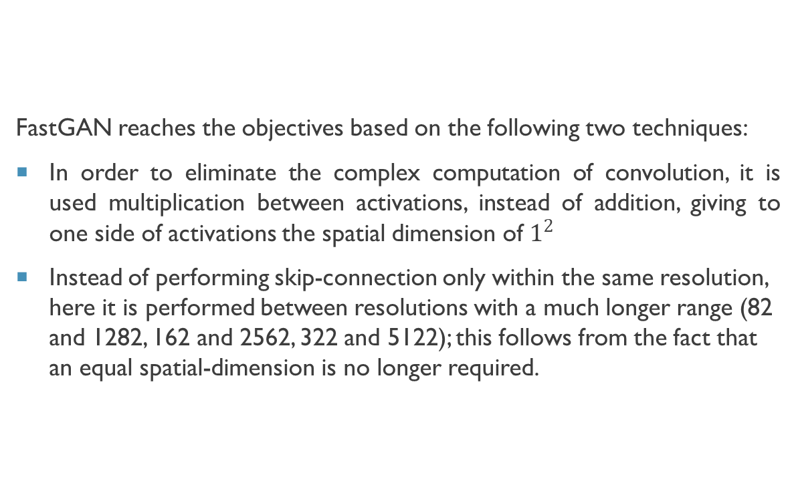
Method: Skip-Layer Channel-Wise Excitation
FastGAN reaches the objectives based on the following two techniques:
In order to eliminate the complex computation of convolution, it is used multiplication between activations, instead of addition, giving to one side of activations the spatial dimension of $1^{2}$
Instead of performing skip-connection only within the same resolution, here it is performed between resolutions with a much longer range (82 and 1282, 162 and 2562, 322 and 5122); this follows from the fact that an equal spatial-dimension is no longer required.

Slide 7
Requisiti tecnici
Rete
Satellite
Collegamento

Slide 8

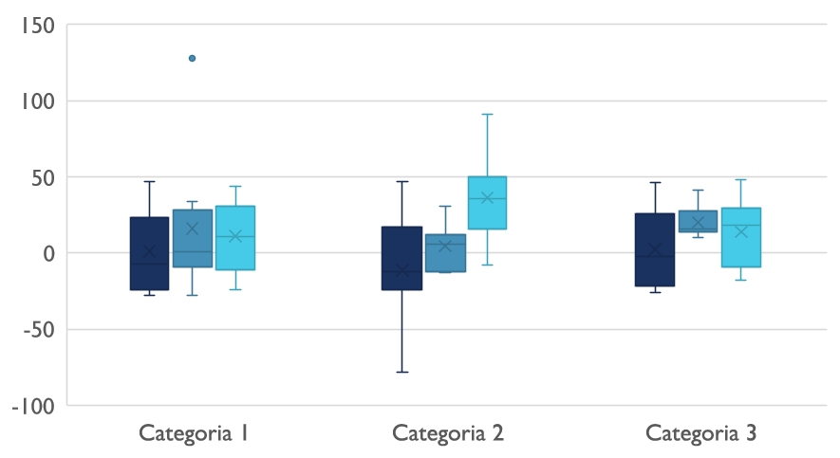
Panorama competitivo

Slide 9

Comunicazioni digitali
Nuvola
Locale
Ibrido

Slide 10

Grazie
prova@example.com

